Slide 1
EE 596 - Image and Video Coding Mini Project
Designing a Image/Video Compression System
Adhasooriya A.M.S.T.
E/15/005

Slide 2
Objectives
1. To investigate the basic functions of an image coding
system.
2. To investigate the basic functions of a block-based video coding system.
3. To investigate the Rate -Distortion optimisation
techniques used in video coding.

Slide 3
Approach
Stage 1: Basic implementation: Image compression (Intra Coding)
Image Transformation (DCT Transform)
Quantization
Entropy Coding (Huffman Coding / Run Length Coding)
Stage 2: Basic implementation 2 : Video compression
Block matching and motion vector using full (Sequential) Search
Motion compensated image formulation
Stage 3 : Improved hybrid video codec

Slide 4
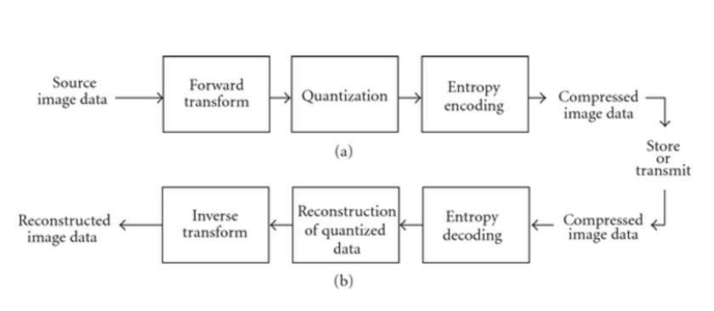
Stage 1: Basic implementation: Image compression
Fig 01: Basic Image compression system

Slide 5
Concise Procedure
Load image
Convert RGB image to Gray image
Divide image into 8x8 marco blocks
Apply DCT
Quantize the image
Encode the image using Huffman encoding
Transmission
Decode the image using Huffman decodng
Reconstruct the image
Apply inverse DCT
Assumption :-
Image is transmitted through a noiseless channel and no distortion occur during the transmission

Slide 6
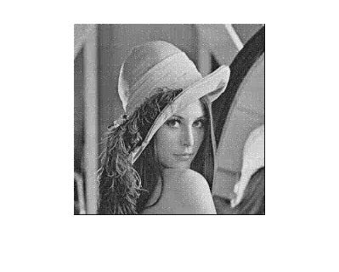
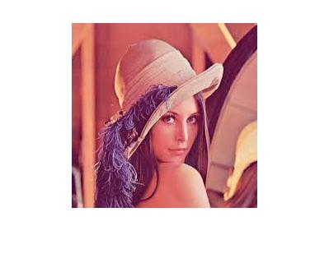



Demo
Compressed Image Q_level 1
Original Image
Compressed Image Q_level 2
Gray Scale Image
Compressed Image Q_level 2

Slide 7
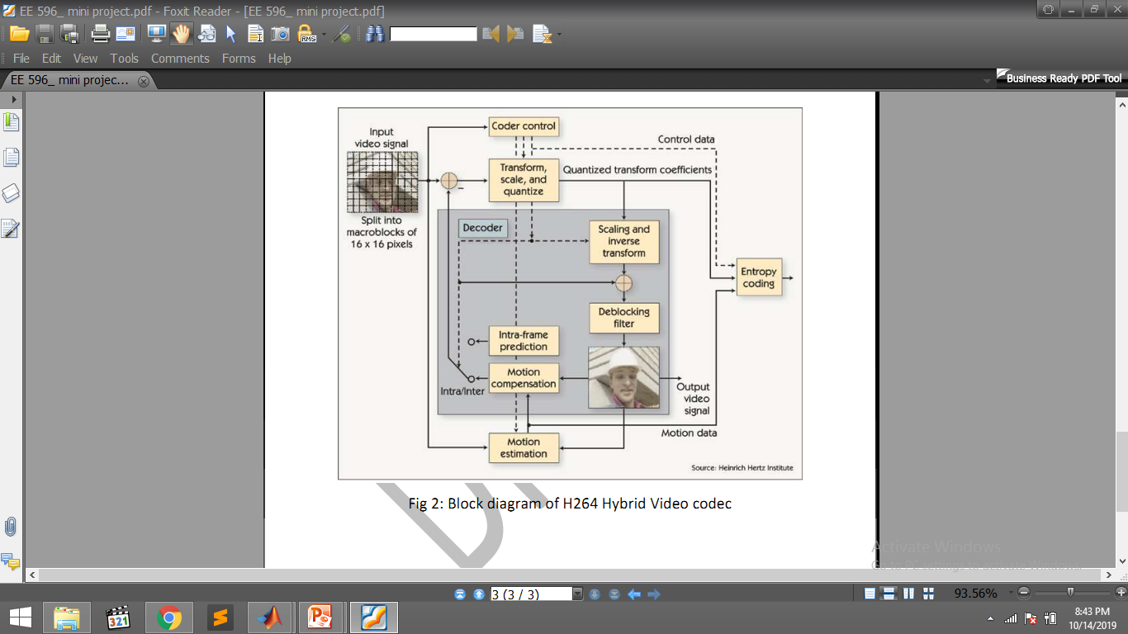
Stage 2: Basic implementation 2 : Video compression

Slide 8
Implementation
Block matching
Criteria used - Sum of absolute difference
Search methord - Full / Sequential search
Motion Vector generation by calculating x axis and y axis displacement between current marco block and best matched marco block
Current marco block is replaced with best matched marco block. By continue this for every marco block, motion - compensated image is obtain.
Difference between motion-compensated image and current frame is calculated as residue

Slide 9
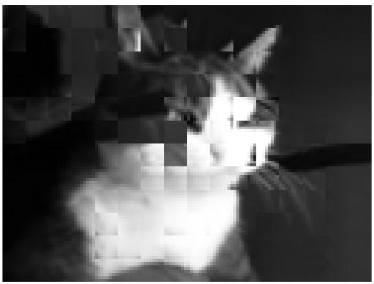
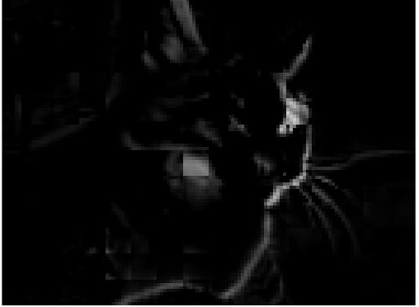
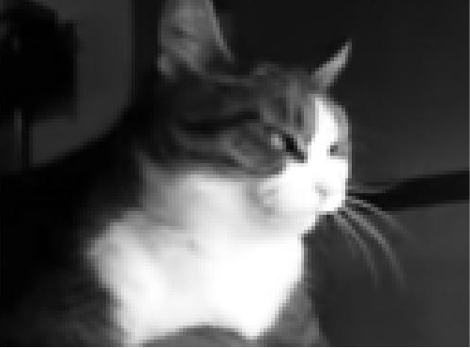
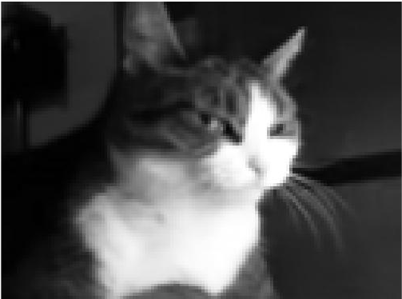
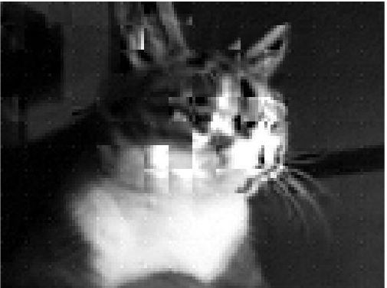
Demo
Reference Frame (I Frame)
Motion - Compensated Image
Residue
Target Frame (P Frame)
Reconstructed Image

Slide 10
Refferences
1.EE4414: Motion Estimation Basics, Yao Wang, 2003
2.STILL IMAGE AND VIDEO COMPRESSION WITH MATLAB, K. S. Thyagarajan,John willey & sons Publications 2011
3. Aroh Barjatya (2020). Block Matching Algorithms for Motion Estimation (https://www.mathworks.com/matlabcentral/fileexchange/8761-block-matching-algorithms-for-motion-estimation), MATLAB Central File Exchange. Retrieved December 9, 2020.

